Slide 1



Terraforming Azure: From getting started to DevOps pipelines

Slide 2
Morgan Jones
12+ Years of IT experience
Cloud Infrastructure Analyst
Go Devils!
www.linkedin.com/in/jones-morgan-
I am not a representative of my current company, Hashicorp, Microsoft, Neudesic, or any other company discussed today.

Slide 3
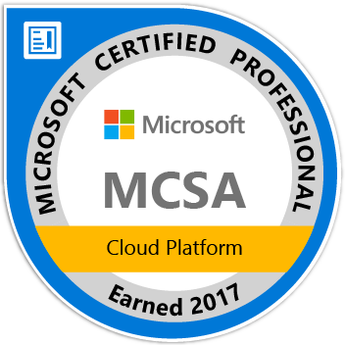



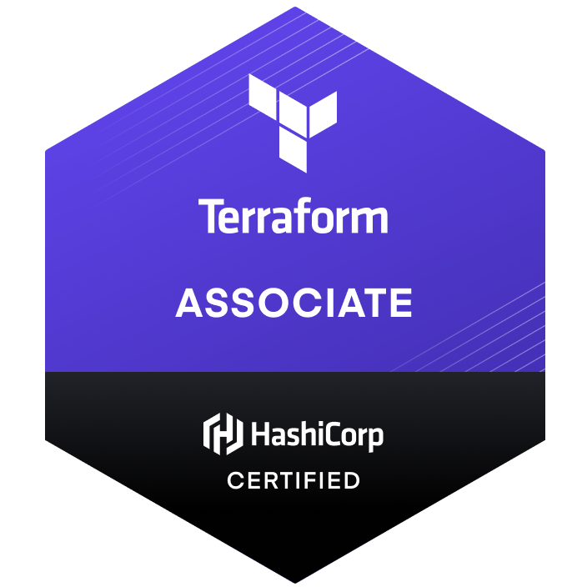



Certifications

Slide 4
DevOps
“DevOps is the union of people, process, and products to enable continuous delivery of value to your end users.”

Slide 5
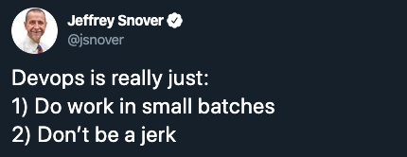
DevOps

Slide 6
Infrastructure as Code (IaC)
Write and execute code to define, deploy, update, and destroy your infrastructure.
Ad hoc scripts, Configuration management tools, Server templating tools, Orchestration tools, Provisioning Tools
An IaC model generates the same environment every time it is applied.
Idempotence
Benefits: Self Service, Agility, Documentation, Validation, Version Control, Reuse
Notes:
Infrastructure as Code evolved to solve the problem of environment drift in the release pipeline. Without IaC, teams must maintain the settings of individual deployment environments. Over time, each environment becomes a snowflake, that is, a unique configuration that cannot be reproduced automatically. Inconsistency among environments leads to issues during deployments. With snowflakes, administration and maintenance of infrastructure involves manual processes which were hard to track and contributed to errors.

Slide 7
What is Terraform?
Terraform is a tool for building, changing, and versioning infrastructure safely and efficiently. Terraform can manage existing and popular service providers as well as custom in-house solutions.
Released in 2014
Current Version: 0.12.12 (October 21st)

Slide 8
Terraform Vs. Other Tools
 | Source | Cloud | Type | Infrastructure | Language | Agent | Master | Community | Maturity
Chef | Open | All | Config Mgmt | Mutable | Procedural | Yes | Yes | Large | High
Puppet | Open | All | Config Mgmt | Mutable | Declarative | Yes | Yes | Large | High
Ansible | Open | All | Config Mgmt | Mutable | Procedural | No | No | Huge | Medium
SaltStack | Open | All | Config Mgmt | Mutable | Declarative | Yes | Yes | Large | Medium
CloudFormation | Closed | AWS | Provisioning | Immutable | Declarative | No | No | Small | Medium
Heat | Open | All | Provisioning | Immutable | Declarative | No | No | Small | Low
Azure Resource Manager (ARM) | Closed | Azure | Provisioning | Immutable | Declarative | No | No | Small | Medium
Terraform | Open | All | Provisioning | Immutable | Declarative | No | No | Huge | Low
Source: Terraform: Up & Running, 2nd Edition

Slide 9
PROVISIONING PLUS CONFIGURATION MANAGEMENT
Source: Terraform: Up & Running, 2nd Edition

Slide 10
PROVISIONING PLUS SERVER TEMPLATING
Source: Terraform: Up & Running, 2nd Edition

Slide 11
PROVISIONING PLUS SERVER TEMPLATING PLUS ORCHESTRATION
Source: Terraform: Up & Running, 2nd Edition

Slide 12
Terraform Workflow
Write
Plan
Apply
Destroy

Slide 13

Configuration Files
main.tf - call modules, locals and data-sources to create all resources
variables.tf - contains declarations of variables used in main.tf
outputs.tf - contains outputs from the resources created in main.tf
*.tfvars – contains variables values

Slide 14
State Files
State is used by Terraform to map real world resources to your configuration, keep track of metadata, and to improve performance for large infrastructures.
This state is stored by default in a local file named "terraform.tfstate”
Direct file editing of the state is discouraged.

Slide 15

Terraform Demo

Slide 16
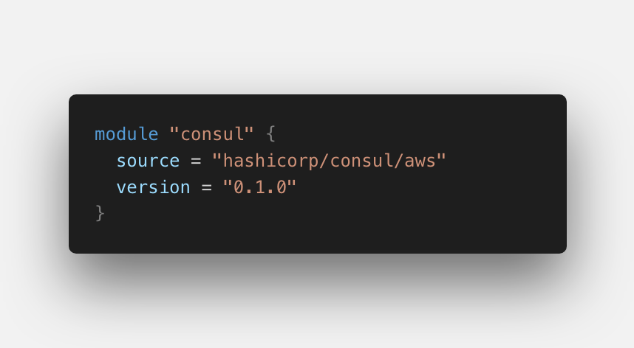
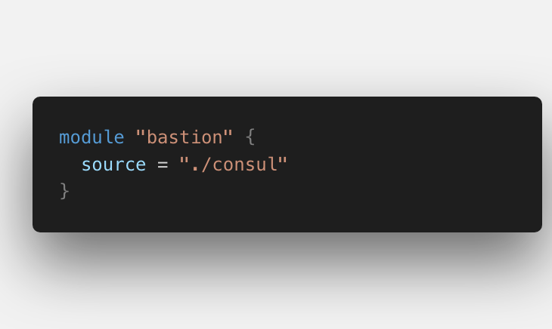
Terraform Modules
Modules are used to create reusable components, improve organization, and to treat pieces of infrastructure as a black box.
Don't Repeat Yourself (DRY)

Slide 17

Teams
Terraform Cloud
Terraform Enterprise

Slide 18
Repo Structure
As a best practice for repository structure, each repository containing Terraform code should be a manageable chunk of infrastructure, such as an application, service, or specific type of infrastructure (like common networking infrastructure).

Slide 19

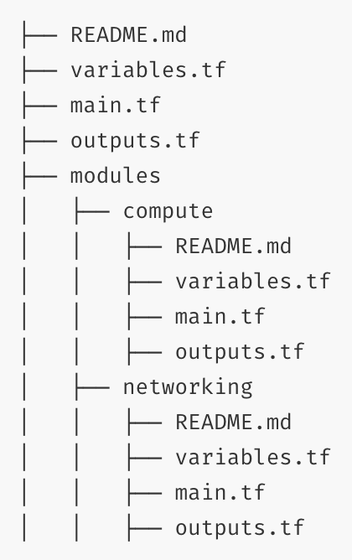
Repo Structure - Branches

Slide 20
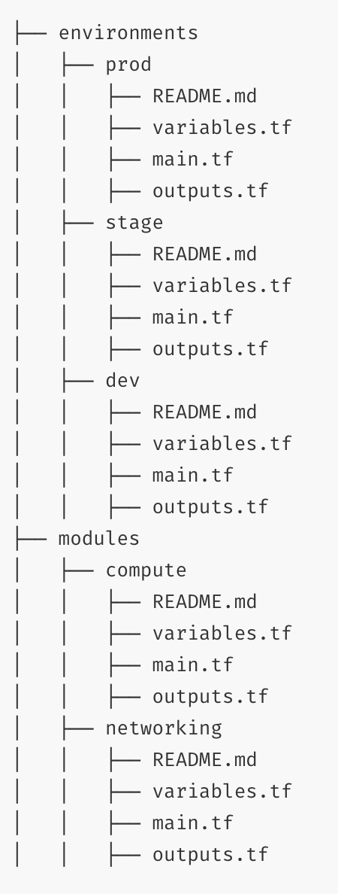
Repo Structure - Directories

Slide 21
Repo Structure - Workspaces
Allow multiple states to be associated with a single configuration
Recommended best practice for multiple environments
“terraform workspace list | select”
The configuration still has only one backend, but multiple distinct instances of that configuration to be deployed without configuring a new backend or changing authentication credentials.
This model will not work for a given repo if there are major environmental differences.

Slide 22
Module Repos

Slide 23
Azure DevOps Demo

Slide 24
Terraform Certification
Beta
https://www.hashicorp.com/certification
https://adinermie.com/hashicorp-certified-terraform-associate-study-guide/

Slide 25
Interesting Terraform Tools
VSCode Extention – Must have!
Fogg – Standardizes repo layout
Terratest – automated testing
Atlantis – Terraform Pull Request Automation
Terragrunt – Wrapper to enforce best practices

Slide 26
Additional Resources
https://www.terraform.io/docs/
https://github.com/terraform-providers/terraform-provider-azurerm
https://reddit.com/r/terraform
https://reddit.com/r/devops
Terraform: Up & Running, 2nd Edition
HashiCorp YouTube Channel
Phoenix HashiCorp User Group
https://github.com/shuaibiyy/awesome-terraform

